Slide 1


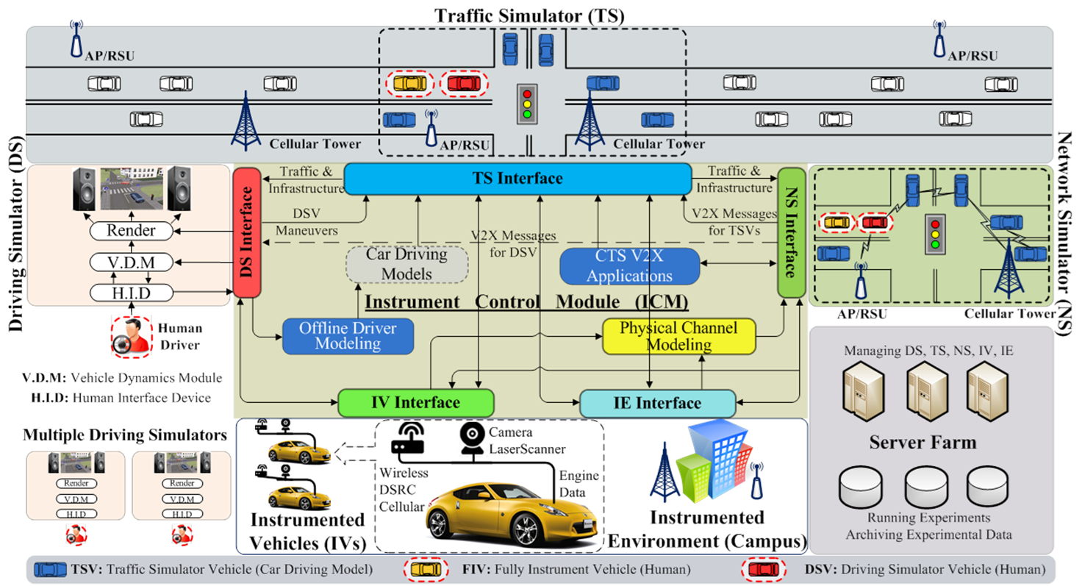
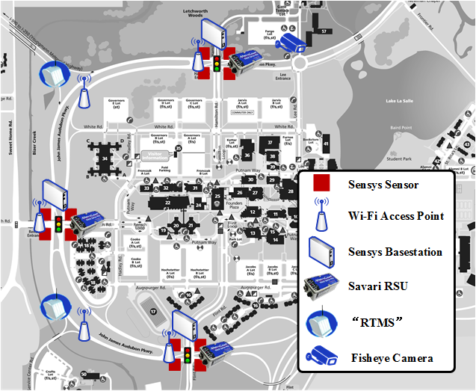
Development of iCAVE² : instrument for Connected and Autonomous Vehicle Evaluation and Experimentation
Xin Liu, Roman Dmowski, Li Tang, Abhishek Gupta, Chunming Qiao, Adel Sadek, Qing He, Sean Wu, Kevin Hulme, Luke Ziarek, Dimitrios Koutsonikolas ¹
xliu47, romandmo, ltang4, agupta33, qiao, asadek, qinghe, seanwu, hulme, lziarek, dimitrio@buffalo.edu
1 Department of Computer Science and Engineering, Civil, Structural and Environmental Engineering, Industry Engineering, University at Buffalo
2 Partners including CMU, Cisco and SwRI.
Introduction
Research Topics and Study Area
This project proposes to develop an instrument for evaluation and experimentation of connected vehicle (CV) and autonomous vehicle (AV) technologies, and enabled Transportation Cyber Physical Systems and applications.
Unlike any existing stand-alone simulator such as driving simulators, traffic simulators, network simulators, this instrument integrates all three different simulators, is capable of simulating connected and autonomous vehicles, and has both hardware-in-the-loop and human-in-the-loop simulation capabilities.
Compared to road testing facilities, the instrument can provide a low-cost and yet a large-scale platform which is powerful and flexible enough to answer many “what-if” questions.
Motivation
Evaluate and experiment for CV and AV technologies
Experimenting with advanced technologies that are still at the design stage can be expensive and time-consuming.
Open road testing may involve high risks, and pose safety threats to participants.
Closed facility used for testing advanced designs results in lost fidelity.
The instrument makes it feasible to study next-generation designs and technologies for CVs and AVs, new transportation infrastructures, and new CTS applications.
Stand-alone simulations
Road tests
Model
Design Concept
Stand-alone simulations: good for initial designs but lacks fidelity
Road tests: high costs and limited flexibility for answering “what-if” questions.
Traffic simulators or TS, mainly for transportation engineering research, provides a virtual driving environment and generates vehicles and fairly realistic traffic.
Driving simulators or DS, involves a human driver who may sit in a vehicle, which is mounted on a motion-platform with multiple degrees of freedom, and surround video/audio for background driving environment and traffic. Accordingly, it can be used to simulate vehicle dynamics and study human factors.
Network simulators or NS, can simulate the communications which take place within a large transportation system with many vehicles and road-side APs, and in particular, it can generate CV-related messages, and simulate how these messages are sent and received, including how much delay and loss rate these messages will experience. Hence, the NS is suitable for studying V2V/V2I technologies.
Instrumented vehicles or IV, including a fully instrumented and several partially instrumented CVs as well as an AV
Instrumented Environment or IE, University at Buffalo (UB) north campus instrumented with traffic sensors, access points and road-side units for vehicle-to-vehicle (V2V) and vehicle-to-infrastructure (V2I) communications.
Fig 2. Workflow between simulators
Fig 1. An Illustration of the Proposed 5-in-1 Instrument iCAVE²
Development
Development Strategy and Methods
Fig 3. Campus Instrumentation
The central component of iCAVE² is ICM with three main interfaces. These interfaces will be designed to support different DSs, TSs, or NSs.
The ICM middleware will be developed with open APIs and as an open-source project to promote participation from the research community, facilitate remote experiments by industry and academic users outside UB.
Conclusion
Useful Conclusions and Thoughts
This study focuses on the travel time reliability of emergency vehicles (EV), which draws little attention in the previous literature. Our major findings can be summarized as:
In summary, the proposed 5-in-1 iCAVE² fills a critical gap between road testing and computer-based simulation, which lack either human-in-the-loop or hardware-in-the-loop functionality (or both). Owing to its 5-in-1 integration, its open-APIs and its open-source nature, the proposed iCAVE² is expected to be a unique instrument that is capable of supporting safe, low-cost, feature-rich, and highly adaptive evaluation and experimentation of various advanced CV and AV technologies and emerging applications.
iCAVE² has the potential to support transformative research within the institution (UB), regionally, nationally and internationally.
Moreover, the integrated simulation capability afforded by iCAVE² will benefit ongoing simulation-based driving research and training pilot studies.
This research was supported by NSF and University at Buffalo. We thank our colleagues from CMU, Cisco and SwRI who provided insight and expertise that greatly assisted the research.
Notes:
Change the format for authors a little
To include everyone from UB on the MRI project, on one line
(list emails as “xliu47, roman, qiao, asadek …@buffalo.edu” ) on the same line if possible – no need to include everyone, just yours
3) List all UB dept on the same line
4) Including a note saying external partners, CMU, Cisco and SwRI.
5) Most importantly, don’t copy sentences in verbatim, use phrases/bullet items –for Model, Motivations/Intro.
6) Modify the figure for gap: have texts like “rod testing” on one side inside the fig and “raod testing” on the other rock isnide the figure.

